Slide 1
The Atom
February 2017

Slide 2
Atoms are made up of:
Protons (P) = positive particles (+)
Neutrons (N) = neutral particles (no charge)
Electrons (e) = negative particles (-)
***The #of P = # e which makes the atom neutral

Slide 3
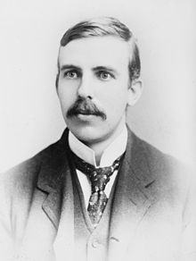
A guy named Rutherford discovered that:
In the centre of the atom sits the __________.
The centre is positive because the _______ are there.
The rest of the atom is mostly empty space.

Slide 4
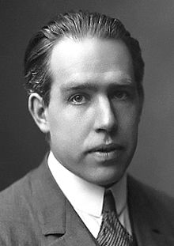
A guy named Bohr discovered that:
The electrons move around the nucleus in “orbits”.
Each orbit can hold a certain number of electrons.

Slide 5
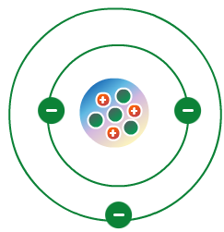
Putting Rutherford’s and Bohr’s ideas together the atom looks like this:

Slide 6
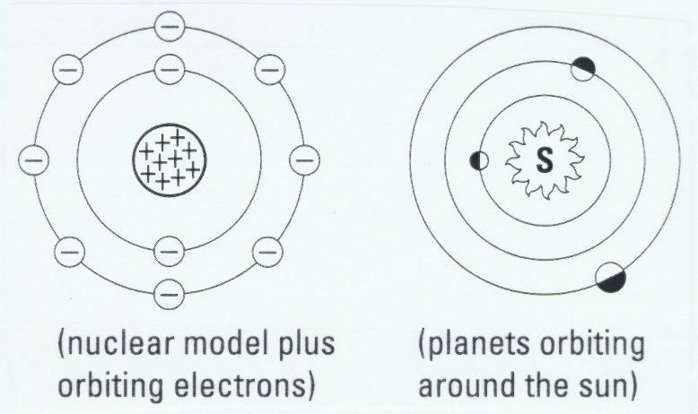

Slide 7
Bohr’s rules:
Orbit #1 (the one closest to the nucleus) can have a maximum of 2 electrons
Orbit #2 can have a maximum of 8 electrons
Orbit #3 and #4 start out by having a maximum of 8 electrons (this changes for bigger atoms)

Slide 8
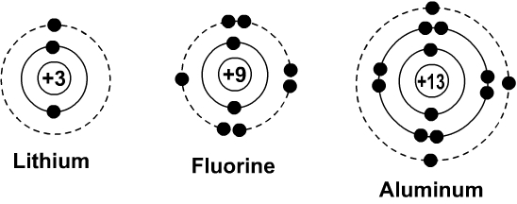
Bohr-Rutherford diagrams

Slide 9
How to draw B-R diagrams:
Find the element that you want to draw on the Periodic Table
The element # = #P
Draw a small circle and inside it write the positive charge of the nucleus
Draw orbits around the nucleus
Starting with the closest orbit follow Bohr’s rules and place the same number of electrons as there are protons

